Slide 1

Notes:
A CoE
Mission to make next generation of energy-efficient digital technologies
Why would we want to do that?

Slide 2

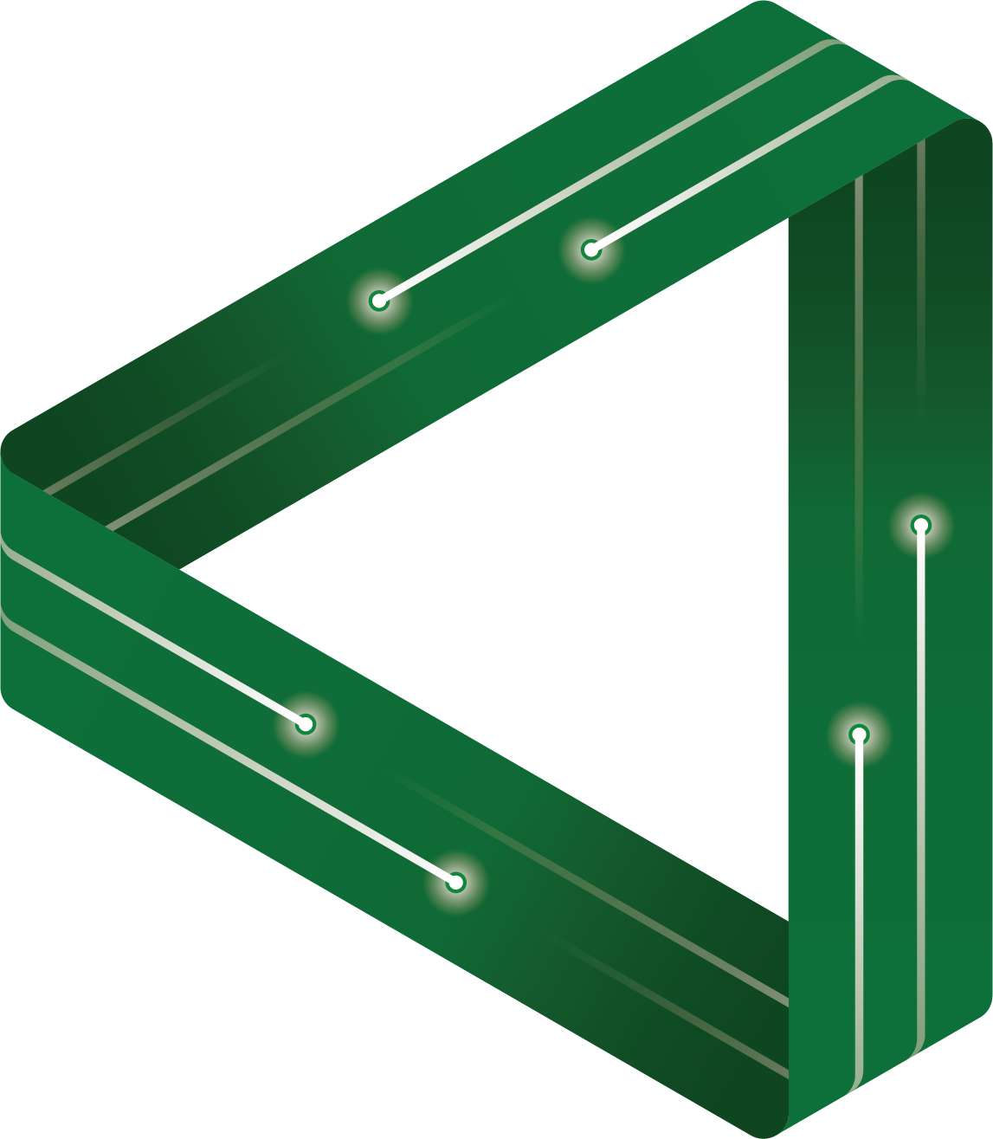







FLEET Schools

Slide 3
Electricity, conductors and insulators
Notes:
Static electricity demonstration – rubbing a balloon on your hair.
The attraction of your hair to the balloon is an example of static electricity.
And so is lightning – next slide

Slide 4

Notes:
What is lightning?
We have watched lightning forever, but it was only 200 years ago that we worked out it was electricity
Only last century did we begin to understand how electricity worked
Electricity brought profound changes to society.

Slide 5
Activity 1. What is electricity?
Work in groups and brainstorm what you know
about electricity.
Answer questions in Activity 1 worksheet.
Notes:
Click on the link for Activity 1. What is electricity – a critical thinking activity. Students work in groups to brainstorm questions and express their answers any way they like – words, images, graphics. This establishes a baseline understanding of students’ perceptions of electricity and its value.
Start a class discussion based on student answers to the questions. What have students identified re: electricity and its implications for humans and how we live our lives, the implications for the environment and our planet. Have any students thought about how science can help solve the problems (hopefully problems identified by students), what we as a society can do about those problems.

Slide 6

To understand electricity
we need to understand the atom
No, not that Atom…
DC comics, Ray Palmer
Electricity is a range of phenomena associated with the flow of charge.
Notes:
We get onto what we mean by ‘flow of charge’ and how we harness this to make our devices and lights works later

Slide 7
Activity 2. Draw an atom
Draw your perception of an atom
Notes:
Click on the link for Activity, Draw an atom. Getting students to draw their initial perception of an atom establishes a baseline understanding.

Slide 8
THE ATOM has 3 core components: proton, neutron and electron
The core (nucleus) is made up of protons and neutrons.
Protons carry a charge, the neutrons have no charge
Electrons surround the nucleus.
Electrons have a charge that is opposite to the charge on the proton.
The number of protons an atom has will determine what element it is. eg: Hydrogen has 1 proton, Helium has 2, Lithium has 3…and so on.
Notes:
Now we start to introduce the atom and the history of scientific endeavour that led to the knowledge we have today

Slide 9
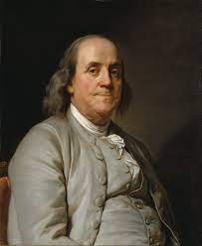
Benjamin Franklin in 1748 suggested there were two types of charge that were opposites.
Notes:
Benjamin Franklin in 1748 (270 years ago) suggested there were 2 types of charge that were opposites (+ and -)
Ask students what happens when you have a positive-positive or negative-negative charge come together [repel or attract]? What about opposite charges – a positive and negative [attract or repel]?

Slide 10
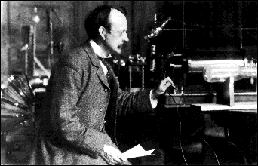
J. J. Thompson’s experiments showed that electrons existed, but his model of the atom was wrong.
Notes:
It was not until 150 years after Benjamin Franklin’s ideas that scientist, JJ Thompson did some actual experiments that showed that electrons exist.
He used that knowledge to develop model of the atom – that was wrong.

Slide 11
J.J. Thompson’s model of the atom
– the plum pudding
Notes:
JJ Thompson came up with an incorrect model of atom that we call the ‘plum pudding’ model. We got that model wrong a few more times as we kept building up our knowledge of how the atom worked.

Slide 12
There appears to be a lot of nothing (space) in an atom.
Nucleus
Electrons
Notes:
We learned that electrons surround the nucleus, but there is a lot of space between the nucleus and electrons. You can do all sorts of outside demonstrations to get students to visualize the distance between the nucleus and electrons, but you will need a sport oval to do it. Otherwise a rough analogy is to imagine you have a ping pong ball in the middle of the MCG (or WACA, GABBA – any large sporting stadium). Inside the ping pong ball are the protons and neutrons. The electrons are way out in the grandstand.

Slide 13
Not an evil eye,
but the quantum view of the atom – where probability rules.
Electron cloud
Notes:
We are still learning today as we delve into the quantum mechanics of the atom.
For example, at the moment quantum understanding of the electron means we cannot precisely say where the electron is, but we give it a probability of being in certain regions around the nucleus – a concept called superposition. Weirder and weirder…
This is where we examine the forces holding the atom together and how those forces affect how the world works and the technologies we have developed with that knowledge. It is a world where weird things happen and it is a world where FLEET researchers work because that is the level of understanding we need to develop the next generation of energy-efficient computer chips and electrical circuits.
To help students begin to get their heads around superposition, try the following analogy: Ask students that after having observed their principal every day for a year, where are they likely to be at 9am. Usually they say places such as their office, school yard or staff room. Ask them what is the probably (likelihood) of the principal being in each of those place. Ask them what the probability is of them being on the roof hanging onto the gutter is (hopefully they say zero chance). Students can then link that to how scientists work out the probability of an electron having a certain position around the nucleus, because they have done loads of testing and they know that there is, for example, there is an 80% chance the electron will be in one specific region and 20% chance is will be in another region, but 0% that it will be anywhere else.

Slide 14
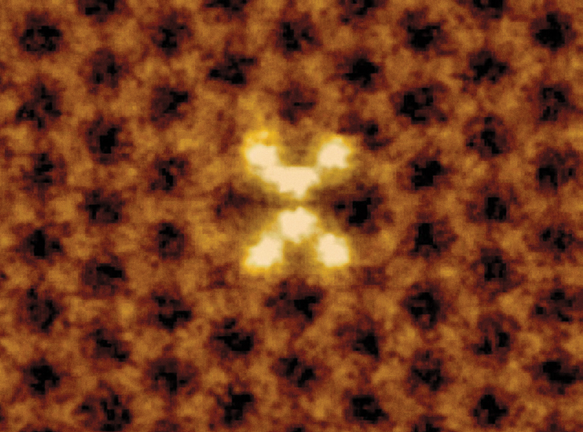
We can now look at single atoms,
pick them up and move them to make new materials
Graphene – thinnest material in the world
ORNL/Science Source
Notes:
Graphene is the thinnest material in the world and 200 times stronger than steel.
FLEET researchers manipulate individual atoms in ways that affect how the electrons behave and flow through materials and generate an electrical current. One of the materials FLEET plays with is graphene.
About here, if you did the demonstration, you might like to explain what was happening with the hair on balloon static electricity demonstration.
Remember how we said that electricity is the flow of charge – Students hopefully now realize that we have electrons buzzing around the nucleus of an atom, but when we make them flow, we generate current (electricity).
With the hair and balloon – when you rub the balloon on your hair you are stripping off all the electrons from your hair and transferring them to the balloon. Electrons have the negative charge. That makes your hair suddenly more positive because it has fewer electrons - ie you left all the positive protons in the atoms that make up your hair. Protons are tightly bound to the atom and do not move. The balloon is more negative because it has all the electrons from your hair.
What happens when you get a positive and negative charge near each other – positive and negative attract. So your positively charged hair is attracted to the negative balloon – hence the sticky out hair.
Sometimes you will hear the crackle of electricity as the electrons move from your hair to the balloon. You see and hear a somewhat bigger crackle with lightning as it moves from the clouds to the ground.

Slide 15
Activity 3. Build an atom
Notes:
Activity 3. Students use their knowledge of the atom to construct a model. Using the periodic table to select an atom helps them realize that there are many types of atoms that make up our living and non-living world – ie that an atom is not an atom – as their different models will visually demonstrate.
Ensure once they understand the limitations of the model they are building, one of which is that the position, and momentum of the electrons is based on the concept of superposition. That is, their momentum and position is based on probability.

Slide 16
Write down two cool things you learned today about electricity or atoms.

Slide 17
Harnessing the power – making circuits
Notes:
Use a prop that will demonstrate how we have harnessed the power of electricity – eg a torch, light switch, computer, etc
Get students to consider how in such a short time (less than 200 years), we have gone from having no electricity to everything we see around us today.
Before diving into the physics of circuits, get students to think about the implications of today’s technologies, which all rely on electricity

Slide 18
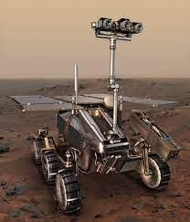
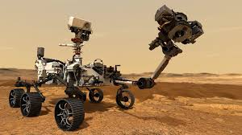
Today, we can put autonomous robots on Mars
Notes:
Consider how today we can put robots on Mars
This – along with all our digital technology – relies on computer chips
Each of those computer chips can have billions of tiny transistors that are the brains of the computer – they are the binary code that computers use to compute stuff.
Transistors are also a type of circuit with a switch. When you turn them on and have electricity flow through them that is a one – switch them off – no electricity and that is a 0. This happens billions of times for just the simple tasks.

Slide 19
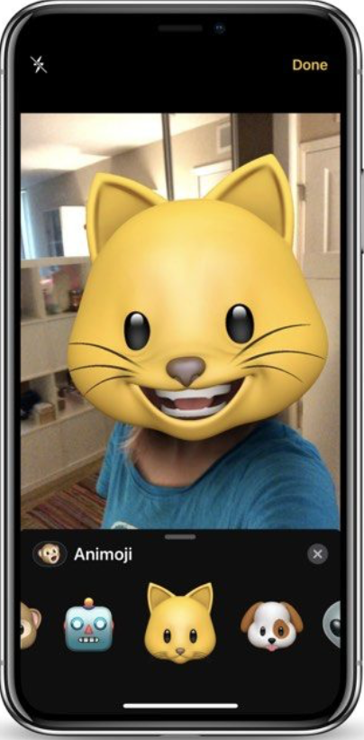
To process one photo on your smart phone requires about one trillion computations….
Notes:
Each computation uses energy – sometimes from a battery, like the one in your mobile phone, sometimes from the electricity coming from the wall socket
And then you send that photo to your friends, upload it to…This uses more energy
Digital technology and energy consumption
How many things do you own are have computer chips in them? Yell them out

Slide 20
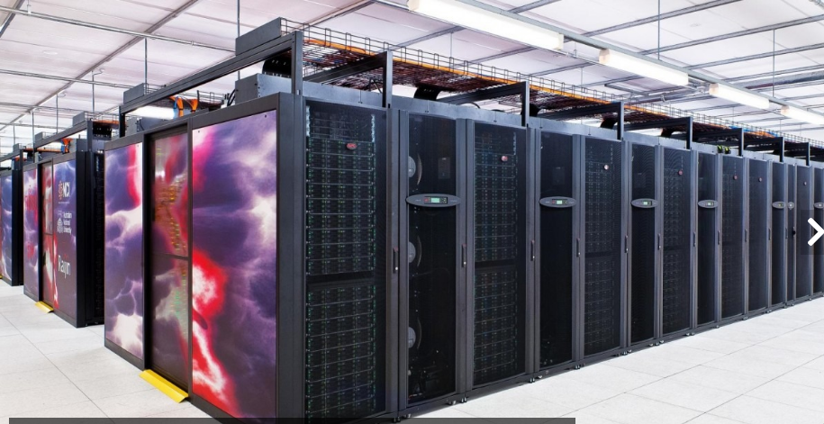
Australia’s biggest super computer uses
as much energy as a Melbourne suburb
Notes:
Australia’s most powerful supercomputer at a university in Canberra uses as much energy as a Melbourne suburb – lot of greenhouse gases. And there are hundreds of these supercomputers around the world.
10% of world’s electricity is used by our digital technology – and this proportion is increasing each year because we are relying more and more on digital technologies to do stuff
So are supercomputers an acceptable use of technology?
Examples of how we use supercomputers: to screen the thousands of genes involved in rare human diseases and cancers to understand their function and develop ways to treat them; to understand the complex ways the climate influences the melting of the worlds ice sheets so we can better manage climate change and even using complex math to find a cure for COVID-19
How acceptable did students find supercomputers?
So what might be some solutions to the problem? FLEET is working on ways to make computers (and any digital technology) a lot more energy efficient.

Slide 21
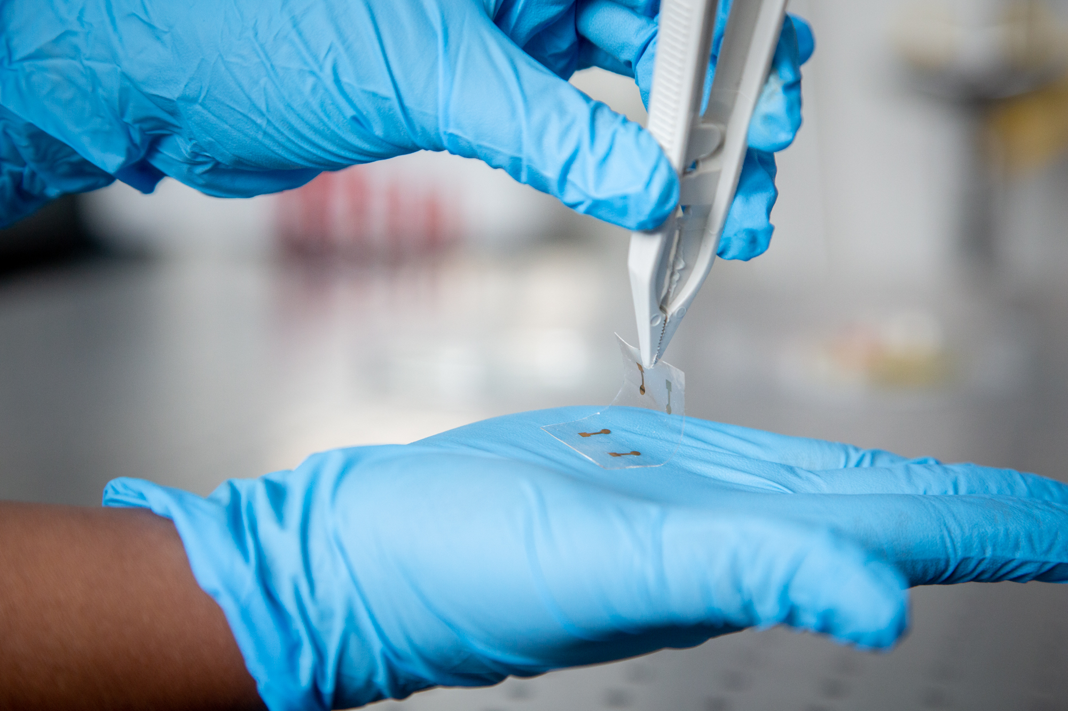
FLEET has made transparent, energy efficient circuits
Notes:
One way FLEET is trying to develop low-energy electronics is by developing more energy efficient transistors – which is a type of circuit,
One of the steps to achieving this is developing novel materials that can conduct a current more efficiently. FLEET’s RMIT-led team has now introduced a new ultrathin two-dimensional (2D) semiconducting material to the growing family of 2D materials. 2D materials are materials that are just one atom thick.
It is still in the laboratory testing stage, but this new 2D material has enabled fast, transparent circuits. They consider some of the potential uses for this 2D material to be in flexible touchscreens that can be printed and rolled out like newspaper. They are cheap and let through more light which would make your touchscreen devices about 10% more energy-efficient.
But what is a circuit – this is a crucial component to any digital technology – anything electrical really. It is also going to be crucial to know if you want to get your LED or light to work in the experiment coming up.

Slide 22
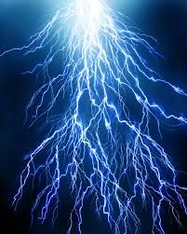

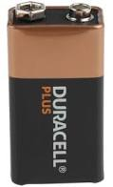
Use the (chemical) force
Notes:
Today we will play with chemical energy – a battery - and we are going to convert chemical energy into electrical energy.
We not magicians – we cannot magic up electrical energy from nowhere.
We need to convert one form of energy into to a form that is useful for what we want to do – that form of energy that is useful to us is electrical energy and later we will use it to make a LED light glow

Slide 23
Notes:
Brief overview on how a battery works. Battery is in two halves. The negative side contain a chemical combination that has lots of excess and mobile electrons that it can donate. The positive side has a chemical combination that makes it highly positive – and attractive to electrons

Slide 24


Activity 4. Draw a circuit
You have a battery, wires and a light globe
Notes:
Click on the link to take you to Activity 4, Draw a circuit. Again, getting students to draw their initial perception of a circuit establishes a baseline understanding. They go on to build a real circuit then we test their new understanding.

Slide 25
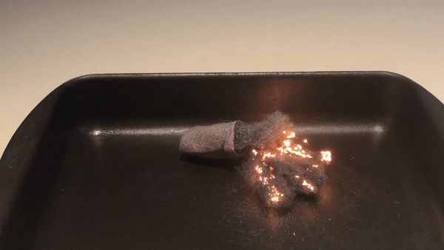
Activity. Electrified steel wool
Notes:
If you have time, consider conducting this dramatic example of a circuit.

Slide 26
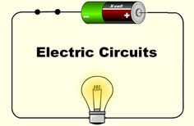
Notes:
Explaining what a circuit is, how it works
Electrons are really tiny – 1000 times lighter than smallest atom so able to pass through materials such as wire in circuits
Ask students, What will happen if I make a cut in that wire?
Any break in that circuit and the current will not flow. An effective circuit needs a power or energy source, in our case that is a battery. The battery is a source of electrons (from the negative terminal) and the force that pushes the electrons through a circuit once you have a closed or complete circuit.
Reiterate what opposite and like charges do – repel and attract
In a closed circuit, the positive terminal of the battery will also pull electrons through a circuit because of the attractive force between the positive and negative charges. Without the source of electrical energy, electrons just move around randomly. When the energy source is present and a closed circuit exists, the electrons are pushed (and pulled) in one direction. But remember it is only the electrons that move through the circuit. It is this movement or flow of electrons that creates the electric current that then enables the generation of electrical energy to power our lights, computers, or any item that runs on electricity. The protons – or positive charged particles – are fixed and cannot move.
Note also that the electrons in the wires connecting the battery to the light globe, in this instance, also flow. The electrons in metal wires are mobile and when the force from a battery is present the mobile electrons in the wire also flow toward the positive terminal. We get onto the difference between conductors and insulators next.

Slide 27

https://phet.colorado.edu/sims/html/circuit-construction-kit-dc/latest/circuit-construction-kit-dc_en.html
Notes:
This simulation is excellent to help reinforce what students will do themselves when they build their own circuit.

Slide 28
Insulators, conductors and resistance…is futile
Conductors are good at conducting electricity
Insulators are bad at it
Resistance is what prevents the electrons flowing through a material
Notes:
Not all materials can conduct electricity. The ones that can do it well, we call conductors. Some are really bad at it and we call them insulators.
The electrons in conductors are only weakly bound to their atoms and they will happily leave their atom and travel through the material with only a small force – eg from your battery.
The electrons in insulators are really tightly bound to their atoms – don’t want to leave without a lot of force – more force than what is in your battery.
Ask students Where would conductors, insulators be useful?
Resistance
Even the best conductors have resistance
Resistance is a property of the material that slows the flow of electrons.

Slide 29
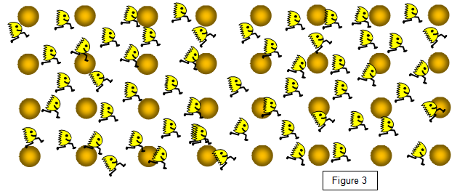
The electrons will interact with the atoms and lose energy
Electrons
Atoms
Direction of electron flow
Adapted from © Keith Gibbs 2020
https://www.schoolphysics.co.uk
Notes:
What do you feel when you have a laptop on your lap or talking on a mobile phone on your ear?
Even best conductors have some resistance– energy in the electron is lost as heat
Insulators have really high resistance. It takes a lot of energy to get electrons to flow through that material.
The more interactions, the greater the resistance and the greater the energy loss. Materials with high resistance can make good insulators because of the difficulty to generate any current.
Materials with low resistance are good conductors because it requires only low voltages, or energy, to get the electrons moving.

Slide 30
Activity 7. Life without resistance
What it would mean if we could conduct electricity without resistance?
How might this affect how we use energy?
What would this mean for society?
Notes:
Click on link for Activity 7. Life without resistance, a critical thinking activity.
FLEET is working on developing atomically thin materials – materials just one atom thick - that can conduct electricity without resistance. These materials will be used in digital technologies to make them use loads less energy. What if we could conduct electricity everywhere we use it without resistance – eg powerlines that go from the coal-fired power station to your home. How much less coal would we need to burn.
In some places resistance in the wires causes nearly half the energy we create to be lost before it gets to your home.
Caution: Students might consider that if we have a material that can conduct a current without resistance that we are enabling massively lethal amounts of current to surge through circuits putting lives at risk. This is not the case. For instance in the case of our graphite circuit that use a 9V batteries (Activity 10), you would only need to use a really low voltage battery if the circuits conducted without resistance. The force or energy supplied to generate the necessary current to make the LED work is just reduced.

Slide 31
Activity 10. Make a circuit
Notes:
Click on the link to take you to a downloadable pdf of Activity 10. Making a graphite circuit. The graphite circuit activity requires only minimal investment in material – essentially just the LEDs and 9V batteries. But students can get equal value from circuit kits and items such as small globes, small electric motors (and plastic propellers to go on them), copper wire and other items to help make circuit building entertaining. Minimal expense required

Slide 32
LED
1cm
2
3
4
9V battery
Graphite circuits
Positive LED terminal (longer leg) on the positive graphite circuit
Notes:
Graphite is a form of carbon it is what your pencil lead is made of. Graphite is just carbon atoms arranged in a particular way. In fact, so are diamond and charcoal. These different forms are called allotropes. They are all carbon, but the way the carbon atoms are arranged is different, which means they have different properties. Diamond is very different to your pencil lead, isn’t it, but they are both just pure carbon atoms. It is only how those atoms are arranged that makes them different.
A single layer of graphite is called graphene, which a really good conductor and incredibly strong. By weight, it is about 200 times stronger than steel. FLEET works with graphene as one of its 2D materials and they add different atoms to it and tweak it in other ways to find brand new materials that can be used in circuits to make them more energy efficient.

Slide 33
Write down two cool things you learned today about electricity, circuits or digital technologies.
Notes:
We have just selected a handful of the activities in the resource to use in the Powerpoint slide. The slide and activities take up about two 1.5 hour lessons.
All the other activities in the resource are at http://www.fleet.org.au/blog/fleet-schools-conductors-insulators-and-electricity/

Slide 34
https://www.fleet.org.au/blog/fleet-schools2/
FLEET Schools

