Slide 1

Notes:
A CoE
Mission to make next generation of energy-efficient digital technologies
Why would we want to do that?

Slide 2

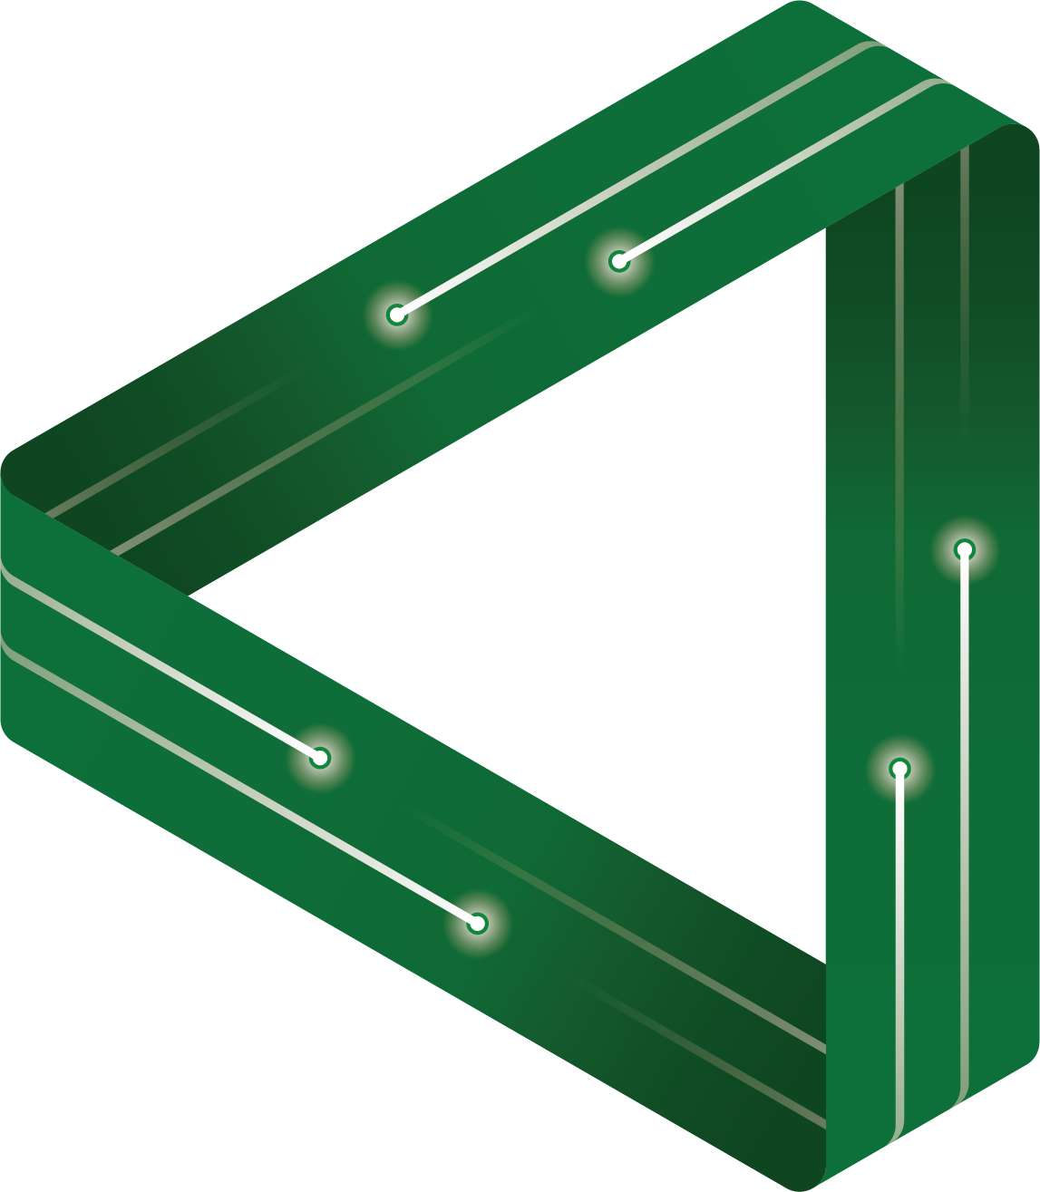







FLEET Schools

Slide 3
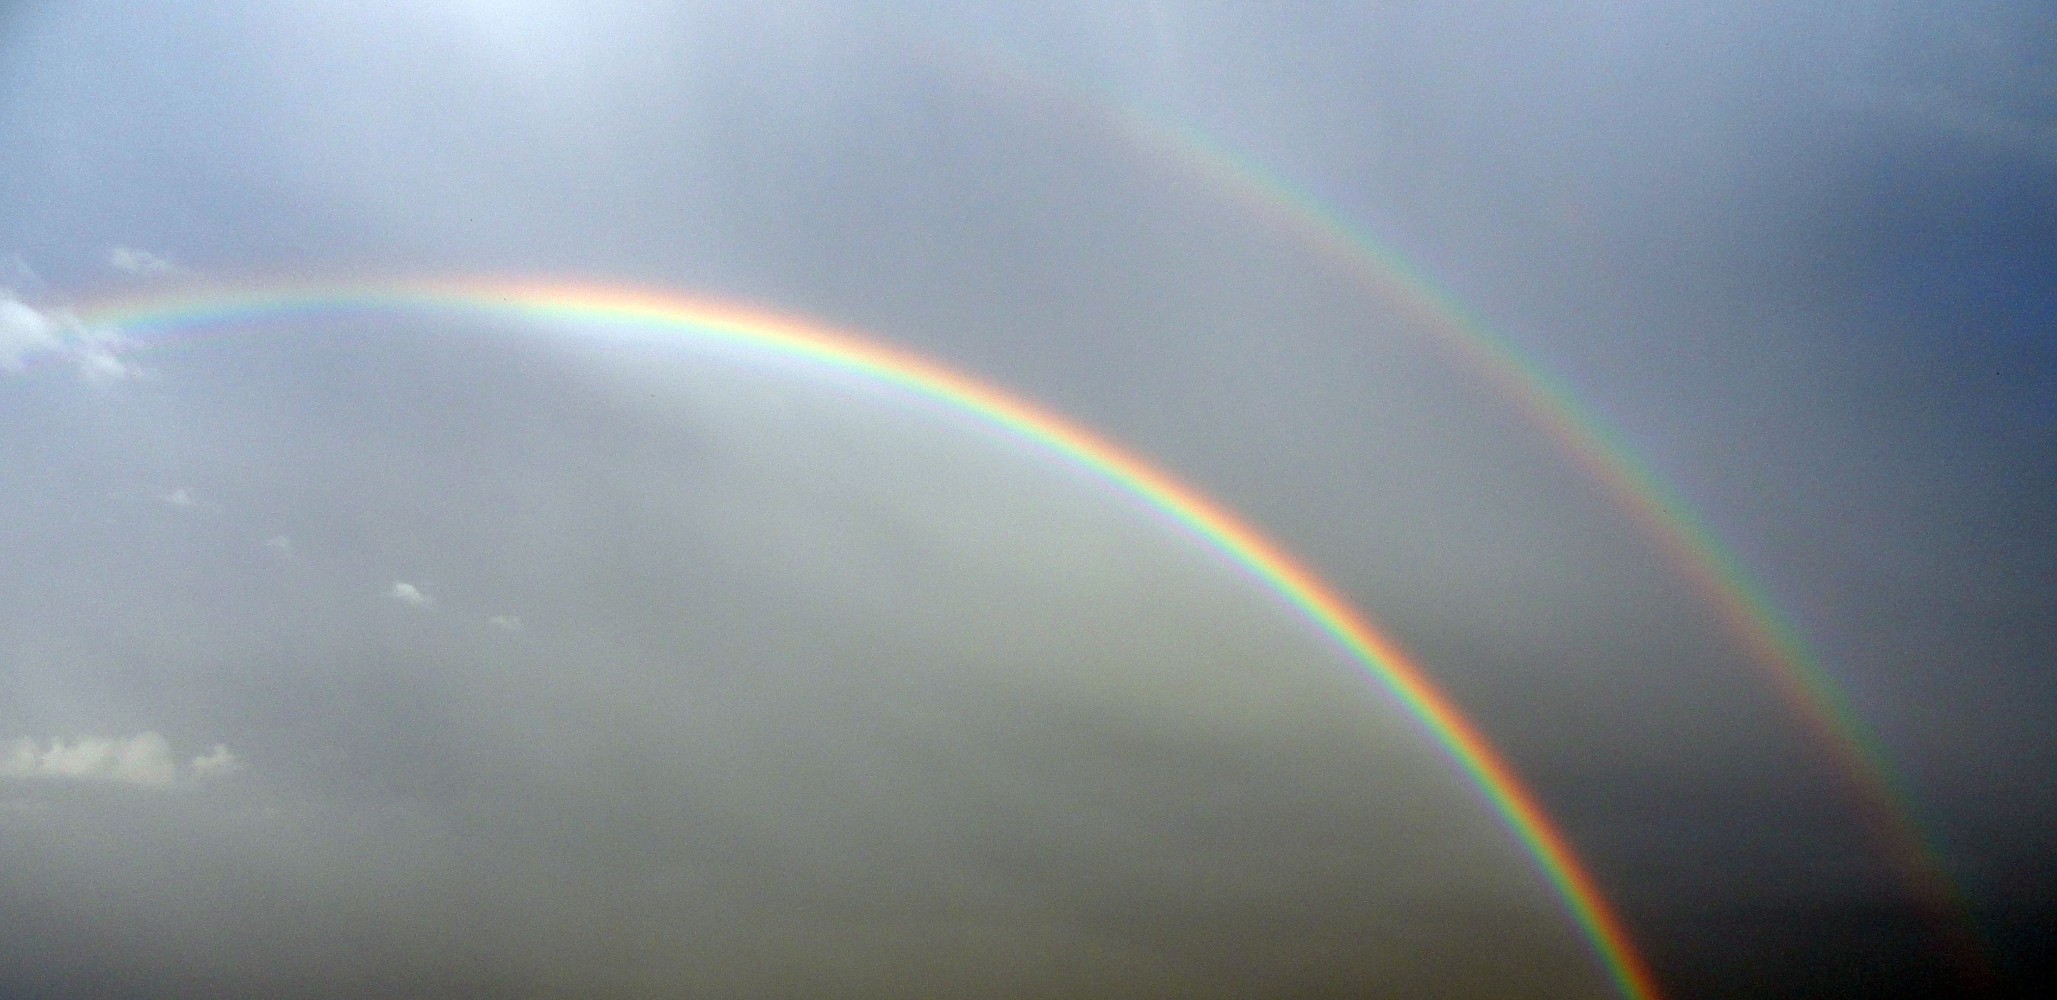
Let there be light
How we see and the fun and physics of reflection and refraction

Slide 4
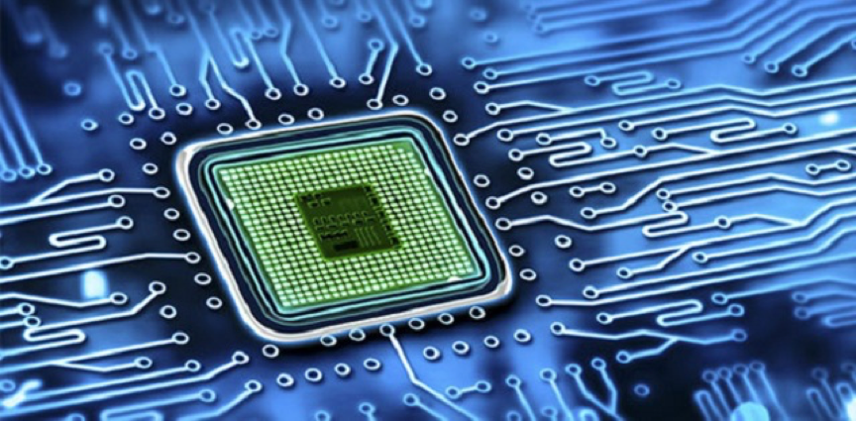
FLEET’s research problem is the increasing energy consumption of digital technologies.
2000 (analog)
2021 (digital)
Notes:
The next few slides and activities provide the context for the physics of light and its relation to FLEET research. We would like students to understand and think critically about the motivation for FLEET research, its value to society (or their perception of its value) and how it applies to the physics of light.

Slide 5

Activity: Talk to two other people next to you and write down 3 things that you own that have a computer chip?
How have these devices changed since you were born? Was there an analog version?
Notes:
Students may not realize that so many more electrical appliances now contain a computer chip – their toaster, cars (modern ones have on average 100), fridges, vacuum cleaners, Fitbits….None of these technologies used to have a computer chip, now they do. Fitbits were not even thought of when most students were born.

Slide 6

Digital demand
The demand for computation is
increasing 70% each year
Notes:
Models vary, but at the moment about 10% of global energy is consumed by digital technologies – regardless the proportion of energy consumed by digital technologies is increasing each year.
There is a physical limit to how much we can continue to shrink the computer chip and we are approaching that limit now. We need to a new way to make computing more energy efficient, or it is predicted that we will soon reach a point where we will not be able to generate enough energy (from fossil fuels, nuclear, wind, solar, etc) to meet the energy demands from digital technology. Estimates for this point in time vary, but range from about 10-20 year.

Slide 7
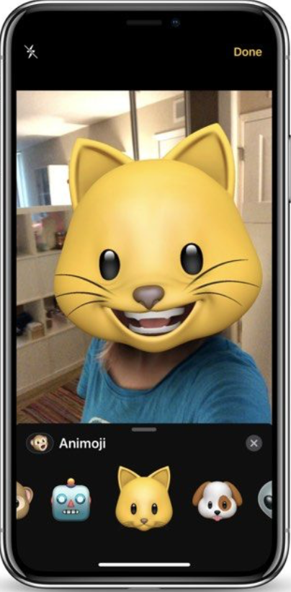
To process one photo on your smart phone requires about one trillion computations….
Notes:
Each computation uses energy – sometimes from a battery, like the one in your mobile phone, sometimes from the electricity coming from the wall socket
And then you send that photo to your friends, upload it to…This uses more energy and it is where a large proportion of the energy consumption occurs as all this form of computation happens in the ‘cloud’ – or large data centres. Each time we “like” or share a photo, or simply post that photo on social media, the computer processing happens in data centres somewhere around the world.

Slide 8
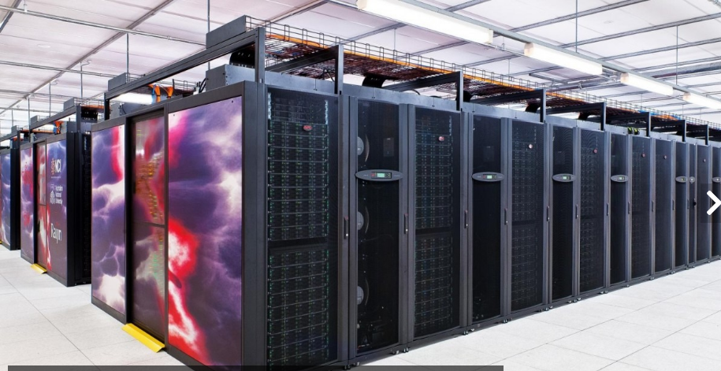
Australia’s biggest super computer uses as much energy as a Melbourne suburb.
Notes:
Australia’s most powerful supercomputer at the Australian National University in Canberra uses as much energy as a Melbourne suburb. That is a lot of greenhouse gas. And there are hundreds of these supercomputers around the world.
As noted, models vary, but about 10% of world’s electricity is used by our digital technology and this proportion is increasing each year because we are relying more and more on digital technologies to do stuff.
This Nature article will give a bigger picture on digitalization and energy - https://media.nature.com/original/magazine-assets/d41586-018-06610-y/d41586-018-06610-y.pdf
So are supercomputers an acceptable use of technology?
Examples of how we use supercomputers: to screen the thousands of genes involved in rare human diseases and cancers to understand their function and develop ways to treat them; to understand the complex ways the climate influences the melting of the worlds ice sheets so we can better manage climate change and even using complex math to find a vaccine/treatment for COVID-19
How acceptable did students find supercomputers?
Should we reach an energy crunch, and digital demand for energy is greater than the energy supply we can generate, would students be prepared to give up some of their time on Netflix, gaming or just turning down the air-conditioner, to ensure there is enough energy to run what is perceived to be crucial digital infrastructure? What would students consider crucial infrastructure?
So what might be some solutions to the problem? FLEET is working on ways to make computers (and any digital technology) a lot more energy efficient.
Can your students think of other ways to tackle FLEET’s research problem (eg more effective renewable energy solutions, computer algorithms to help drive energy efficiency – switching lights off in rooms when nobody is there, etc)

Slide 9















Light is one of the most extensive carriers of information (data)….satellites, TV, phones, emails, photos, radio…
Notes:
Now, let us examine the physics of light.

Slide 10






Understanding light has led to the development of microscopes, microwave ovens, telescopes, X-rays, lasers, our optical fibre network, sending and receiving signals worldwide via satellites, even development of an artificial (bionic) eye…
What else?
Notes:
Light can help describe most of the physical universe around us. As one of the most extensive carriers of information, we can study and learn about some of the smallest things such as atoms and bacteria, to the most distant and largest such as stars and galaxies. Understanding light has led us into the quantum world where some of the deepest-held secrets of the universe are being revealed.

Slide 11
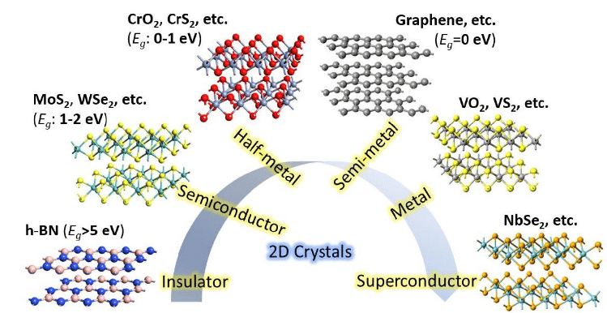
FLEET uses light to develop and understand behaviour/properties of thin materials (1 atom thick) and electronic circuits for the next generation of energy-efficient electronic technologies.
Notes:
Light can be used to control the properties of these 2D materials and therefore the function of the technologies they are employed in.
We have gone from the discovery of graphene in 2004 – the first 2D material – to a 2D material zoo that have a range of properties and functions.
2D materials typically have strong in plane bonds. Pretend you have a bed sheet you can pull, stretch, them – very strong – hard to break. Graphene, is still regarded as strongest material in the world under these conditions.
Depending on the material they can be excellent conductors, or insulators or semi-conductors. These properties is what FLEET and other research teams worldwide are exploring to develop digital technologies that will be extremely energy-efficient.

Slide 12
But what is light?
Activity: Work in small groups and brainstorm what you think light is.
Notes:
From Teacher Resource, Activity 1. Students work in small groups and think about and discuss what they think light is. Use the whiteboard, butchers’ paper or a share document (eg, Google docs) to write down their ideas using descriptions or drawings/images. Can the students explain the rationale for their theories? Get the students to communicate and present their thoughts with other groups. Compare and contrast each group’s thoughts in a class discussion.

Slide 13

What about sound?
Activity: What makes light different to sound?
Notes:
From Teacher resource, Activity 1. Select two students. Get one student to hide behind a wall/obstacle out of sight. Can students hear the hidden student when
they speak, even though they can’t see them? Why can they hear each other, but not see each other? What makes light
different to sound?
Questions for students to consider can include, can light curve and travel around corners/obstacles? Can sound? The ear and eye are different in their abilities, which also has a role here. Ears can detect sound waves from any direction. Eyes cannot. Eyes can only detect light waves from a limited angle from the source it is reflected off.

Slide 14
How do we see?
Activity: Work in small groups and brainstorm how you think we see. Draw pictures, use words, whatever works…
Notes:
From Teacher Resource, Activity 1. Back to the whiteboard and butchers’ paper. Get students to illustrate and then explain how they think we use light to see.
Deeper thinking: Get students to illustrate how light travels. How many students show it travelling in a straight line and reflecting off objects? Get students to use ray diagrams.
This activity is to establish a baseline understanding. The activities that follow will enable students to critically examine and reflect on their understanding.

Slide 15
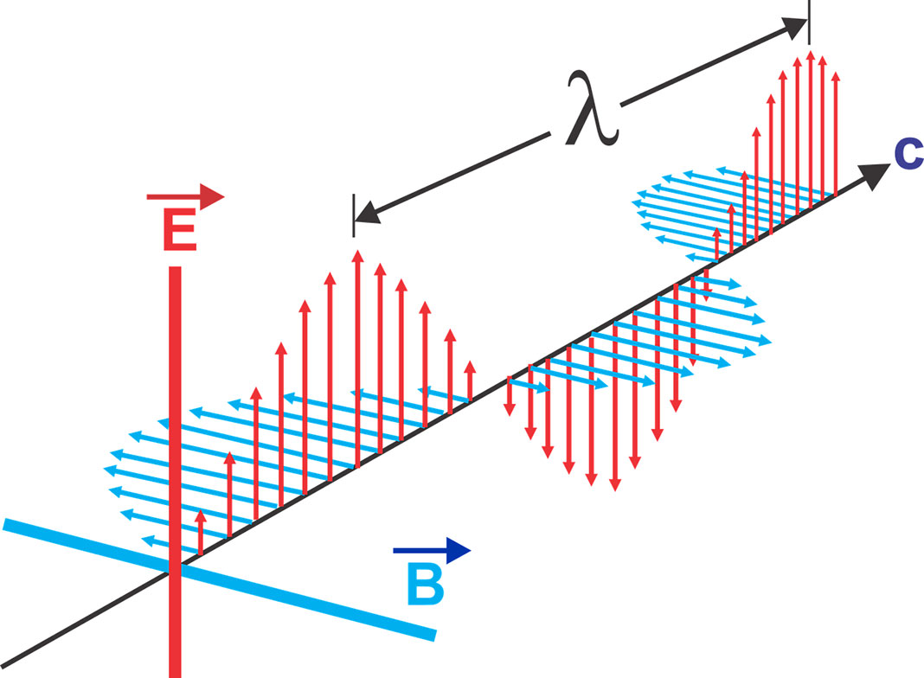
Notes:
Getting into the physics. Light is a packet of energy that exists as a particle and a wave – an electromagnetic wave. As the light moves it generates a magnetic field. Remember that light is massless and the key point here about a photon (light) is about its energy, not the space or size of the elementary particle because a photon does not actually occupy space in the same way you think of a classical object such as a bacterium, rock or planet.
The red arrows travelling up and down represent the electrical field. The blue arrows oscillating left and right (horizontally) represent the magnetic field. The two operate in tandem to exist as light – the electromagnetic wave
.

Slide 16
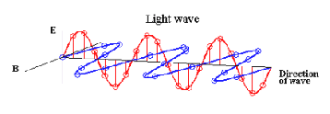
Notes:
Light is a packet of energy.
The simplest form of light is a photon, which is an electromagnetic wave that as it moves – oscillates – it produces an electrical and magnetic field. One does not exist without the other and together, it makes up the electromagnetic spectrum.
The electromagnetic wave has a forward motion, but it is the energy that propagates forwards rather than anything physical.

Slide 17
Amplitude
The wavelength of a light wave is measured as the distance between two peaks
Notes:
The amplitude is the height of the wave

Slide 18
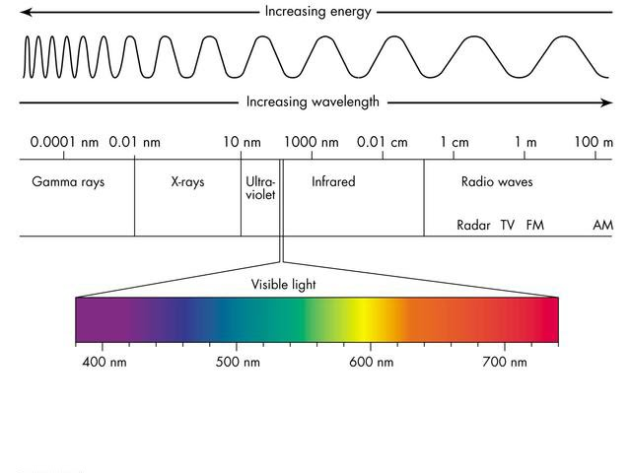
(Image: Cyberphysics)
Notes:
The energy of the wavelength increases with its frequency (number of oscillations per unit of time). Note the tiny proportion of the spectrum that makes up the visible spectrum. (Image: Cyberphysics)
Therefore, gamma rays have a lot more energy than radio waves. Infrared, while invisible to us, is what we feel as heat.

Slide 19
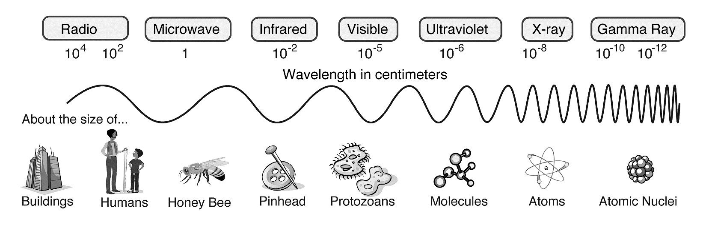
(Image: National Geographic Education Blog)
Notes:
The distance between light waves (their wavelengths) determines the type of light it is. The distance will range from kilometres to lengths about the width of an atom, but they all travel at the same speed, the speed of light. (Image: National Geographic Education Blog)

Slide 20
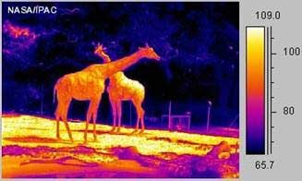
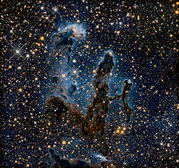
Watch and learn about animal behaviour at night
(Image: NASA/JPL-Caltech, Linda Hermans-Killam)
Looking at our universe differently using infrared light. Eagle Nebula’s Pillars of Creation.
(Image ESA/Hubble)
Notes:
Thermal imaging cameras use infrared light to detect heat. Such cameras help us see things at night, at least those that give off heat anyway. Courtesy NASA/JPL-Caltech, Linda Hermans-Killam
So…could you see a rock at night using thermal imaging? You could if it had absorbed heat from the Sun during the day and was radiating that heat out at night, but not so well if the rock was the same temperature as the ground and other physical objects around it. In other words, the rock was not giving off a heat signature that could differentiate it from other physical objects.

Slide 21


We can see objects because light reflects off that object and into our eyes
Ooh, look superman…no sorry, a bird
Notes:
Reflection. Light is reflected off objects in a straight line. That light must enter our eye for us to see the object, which is why we can’t see the student hiding, but we can still hear them.
Students can do Activity 3, The Light Box that will get them to test the role of light in vision.

Slide 22
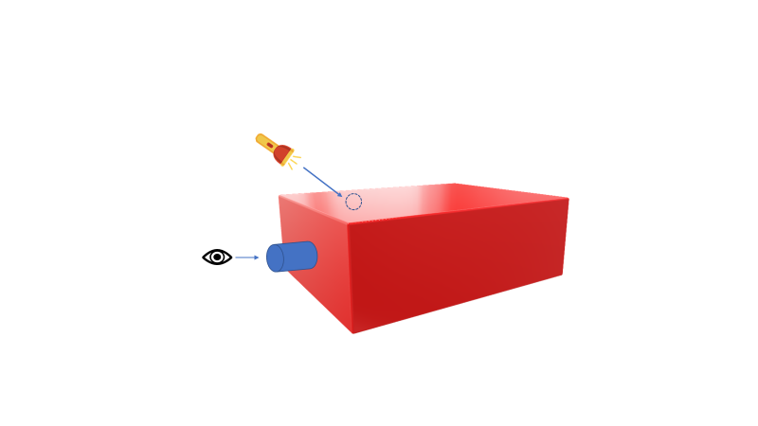
Use the Light Box to understand how light helps us see.
(Torch image is by Unknown Author and is licensed under CC BY-NC)
Notes:
Reflection: From Activity 3, Light Box. Use a section of cardboard tube as the eye piece to look inside the box. Cut a hole the size of your light source to shine into the box.

Slide 23
The angle of incidence (i) is equal to the angle of reflection (r)
N
I
R
i
r
Mirror
Torch image is by Unknown Author and is licensed under CC BY-NC
Notes:
The way light reflects off a surface is predictable and follows the law of reflection. Essentially, if light hits a mirror at one angle it will be reflected from the mirror at the same angle.
Or in more mathematical terms the angle of incidence (i) is equal to the angle of reflection (r). In this image, I is the incident (incoming) ray; R is the reflected ray; N is the normal line, which is an imaginary line that is perpendicular to the surface the light reflects off (a mirror in this case). The angle of incidence (i) is the angle between the incident ray and normal; the angle of reflection (r) is the angle between the reflected ray and normal.
To explore the nature of reflection and how it enables us to see, students can do Activity 3, Light Box.

Slide 24


Mirror
Mirror
Torch image is by Unknown Author and is licensed under CC BY-NC
Notes:
Reflection: After students do Activity 3, The Light Box, they can have some more fun using mirrors to find objects hidden around different corners or obstacles they set up. They can use a protractor to calculate angles of incidence and reflection. Get them to draw their creation and add in the ray diagrams including the angles of incidence and reflection.

Slide 25
Refraction is when light changes direction and speed as it passes from one medium to different medium
Light
Light
Air
Water
Air
Normal lines
Notes:
Refraction: While light travels in a straight line, when it passes from one medium into another, for example from air to water, it will change speed and change direction. This is called refraction.
Do Activity 5, Appearing coin to introduce students to refraction

Slide 26
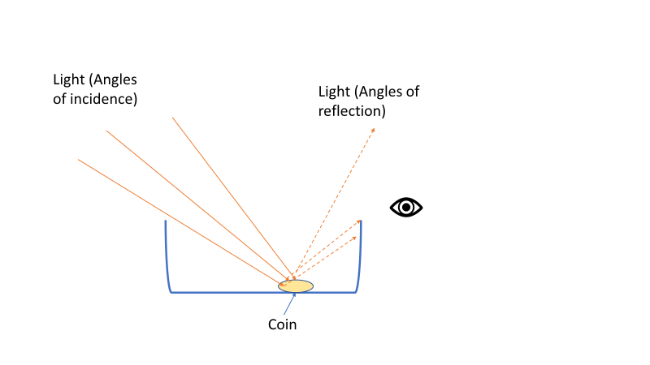
Without water, there is no refraction and light reflecting off the coin does not reach our eye
Notes:
From Activity 5, Appearing Coin. As light reflects off the coin in a bowl without water, there is no refraction and if our eye is positioned below where the reflected light passes, we cannot see the coin.

Slide 27
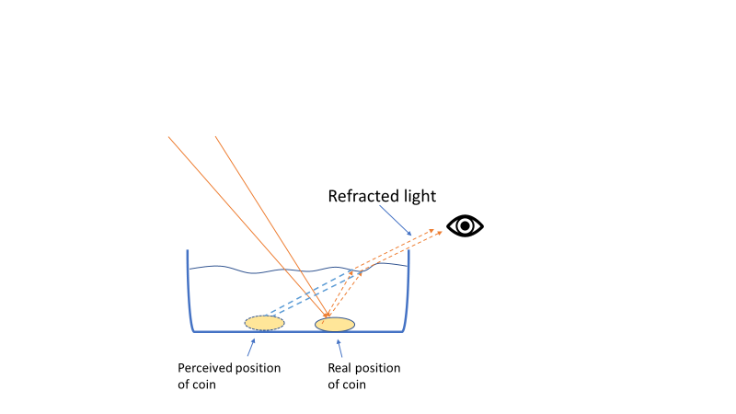
With water, light refracts as it leaves the water enabling it to enter our eye and see the coin.
Notes:
When light reflects off the coin in the bottom of the bowl and exits the water, it changes direction (refracts). This change in direction enables the light to enter our eyes and makes the coin visible. The refraction of the light, however, makes the coin appear to be in a different position from where it really is (ie the coin and our eye have not changed position. The refraction creates this optical illusion).
(Note: In reality, the light entering the water to reflect off the coin would refract as it enters the water and then refract again as it leaves. For simplicity, we have only shown it refracting as it leaves the water to enter the eye.)

Slide 28
Describe two cool things you learned today about light or digital technologies.
Notes:
We have just selected a handful of the activities in the resource to use in the Powerpoint slide. Select and use what is appropriate for your class or lesson plan.
All the other activities in the resource are at https://www.fleet.org.au/blog/fleet-schools-light-reflection-refraction-diffraction/

Slide 29

education@fleet.org.au
https://www.fleet.org.au/blog/fleet-schools2/
FLEET Schools
https://www.facebook.com/FLEETaskthephysicists

