Slide 1

Notes:
A CoE
Mission to make next generation of energy-efficient digital technologies
Why would we want to do that?

Slide 2









FLEET Schools

Slide 3
In the following slides, name the forms of energy in images. Are they examples of kinetic or potential?
Give an example of what energy form the energy shown can be transformed into

Slide 4
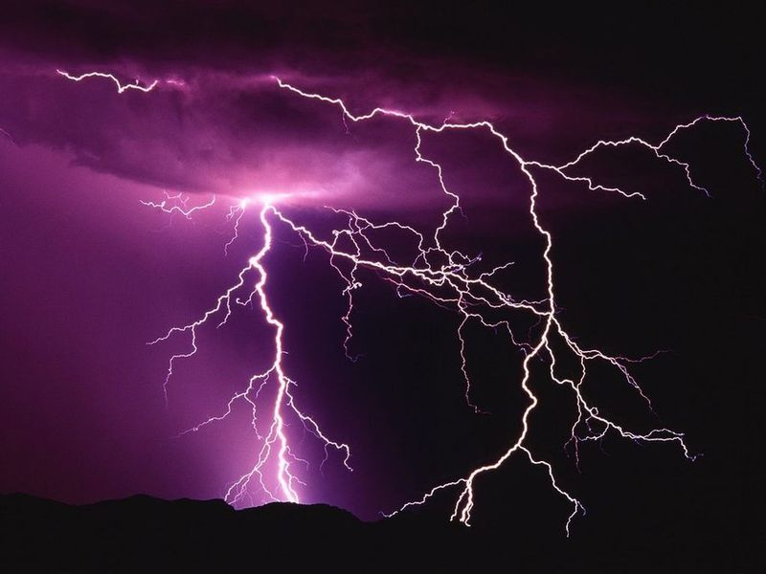
Notes:
Kinetic – electrons moving through the air generate electrical energy (current)
The electrical energy is transformed into light (which is a form of kinetic energy – electromagnetic waves and/or photons propagating through space
Thermal energy (heat) – the air around the lightning heats up hotter than the sun (fact check)
Before the lightning occurs, however there is a massive amount of potential energy that builds in the clouds. That is, you have the build up of electrons in the clouds. The earth is more positive (but air is a good insulator – there the difference in charge between the clouds and earth (or other positive regions of the sky) has to be massive for the electrons to flow from cloud to the positive region. Once there is that flow of charge you have kinetic energy.
[Only 200 years ago humans worked out that lightning was electricity
Only last century (20th) we began to understand how it worked]
Electricity brought profound changes to society.

Slide 5
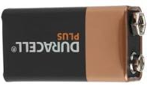
Notes:
Potential chemical energy in the electrons and protons in the anode and cathode. Once connected to a circuit, the potential chemical energy is transformed into electrical energy because it enable the electrons to flow (kinetic energy) through the circuit. The electrical energy then does works such as drives electric motors, computations in your computer chip, provides light, heat, etc

Slide 6
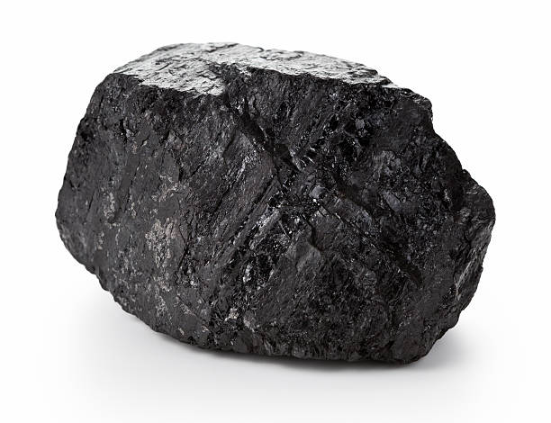
Lump of coal…(don’t) be afraid
Notes:
Potential chemical energy found in the C-C bonds of the coal. If you add some energy, you can break those bonds to release more energy in the form of heat that we can use to turn water into steam that drives a generator (kinetic energy) to generate electrical energy.

Slide 7
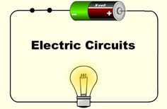
There is more than one form of energy here
Notes:
Electrical - Kinetic via flow of electrons. (Note: that the flow of electrons – kinetic energy – is not electrical energy. The flow of electrons is what enables the generation of electrical energy)
Potential chemical energy in battery
Light and thermal energy from the light bulb
(Note: an interesting comparison and example of some human ingenuity is the incandescent v fluorescent v LED lighting. Compare the minimum current required to get each of these light sources to work, and what heat they generate. You will find the LED generates almost no heat (certainly none they can be readily felt by touch) and compared to incandescent lighting it requires barely any current to turn on.)

Slide 8
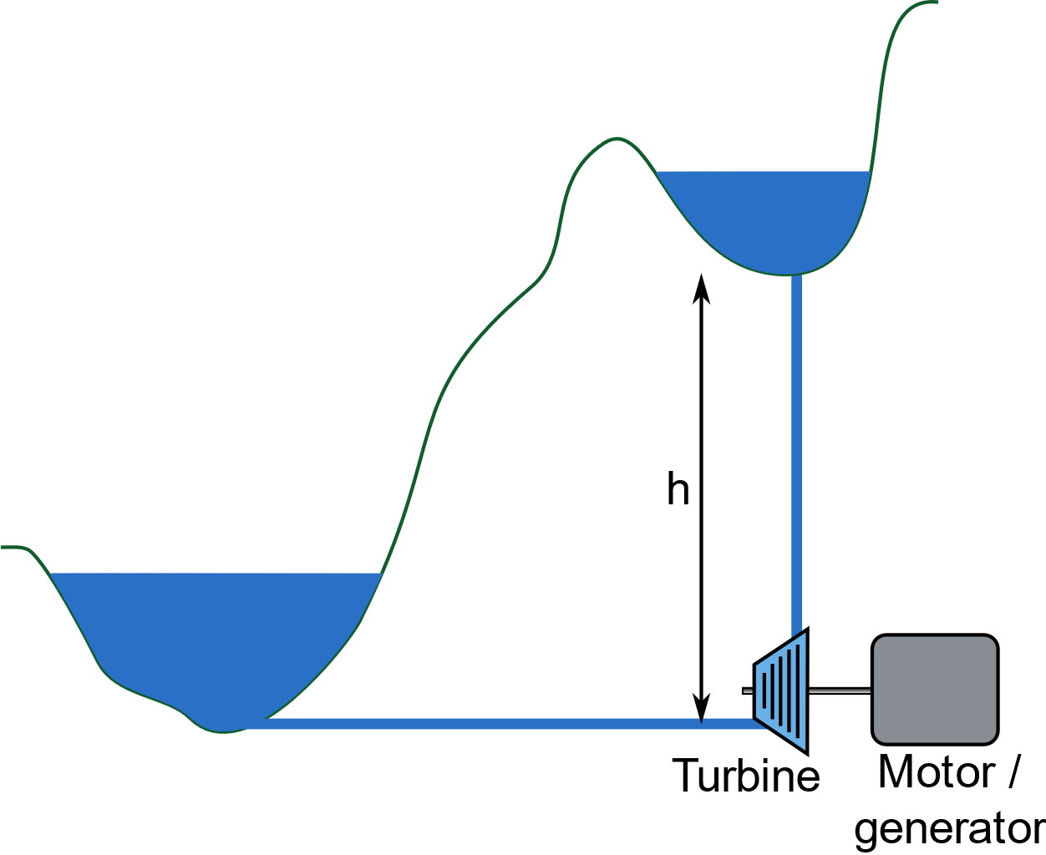
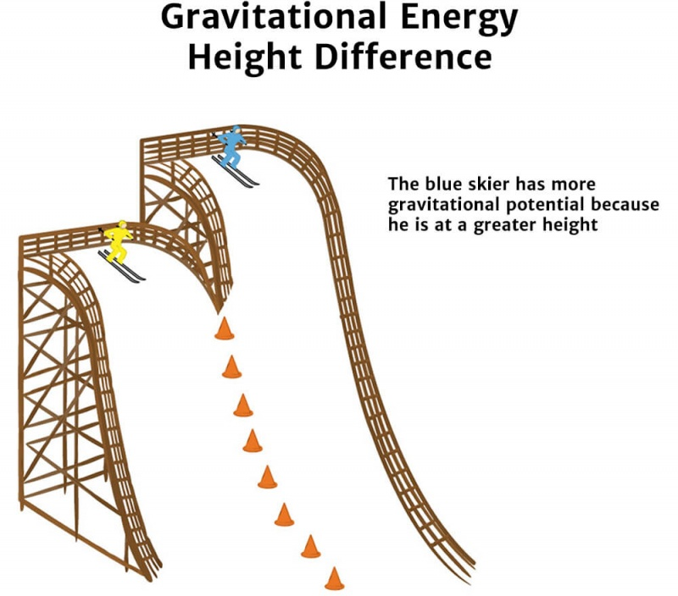
How have we turned this form of energy into something useful?
What are some ways to get the water to the top dam?
Water pumped to top dam
Water released to bottom dam
These skiers have what form of energy? Which one has more of that energy?
Image: Khan Academy https://www.khanacademy.org/science/physics/work-and-energy/work-and-energy-tutorial/a/what-is-gravitational-potential-energy
Notes:
Which skier has the greater potential energy? Hopefully students will select the skier on the highest platform. (Assume each skier weighs the same)

Slide 9

Notes:
Kinetic energy from the movement of the skateboard and the muscles used to propel the board
Potential energy in the form of chemical potential energy found in the human body (all the energy in the chemical bonds found in the metabolites that come from the food we eat), which we convert into heat and kinetic energy in the movement of muscle movement

Slide 10
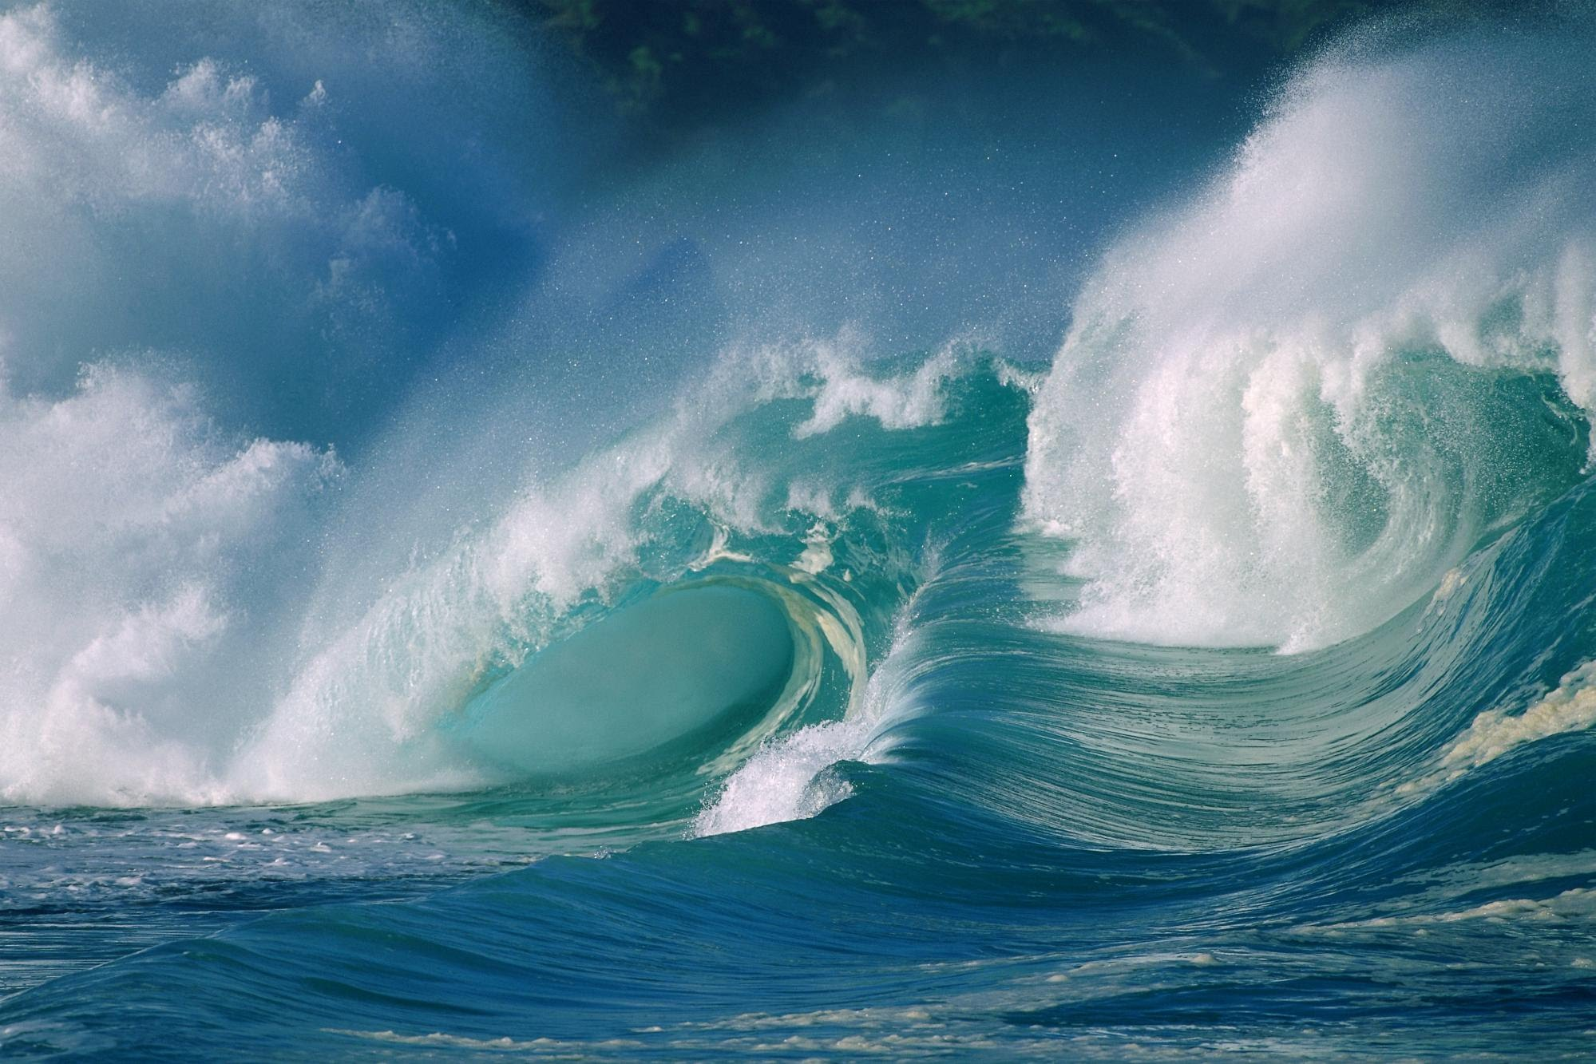
Notes:
Kinetic energy (we can turn kinetic energy from waves into electrical energy). The kinetic energy in waves also does work such as erosion

Slide 11
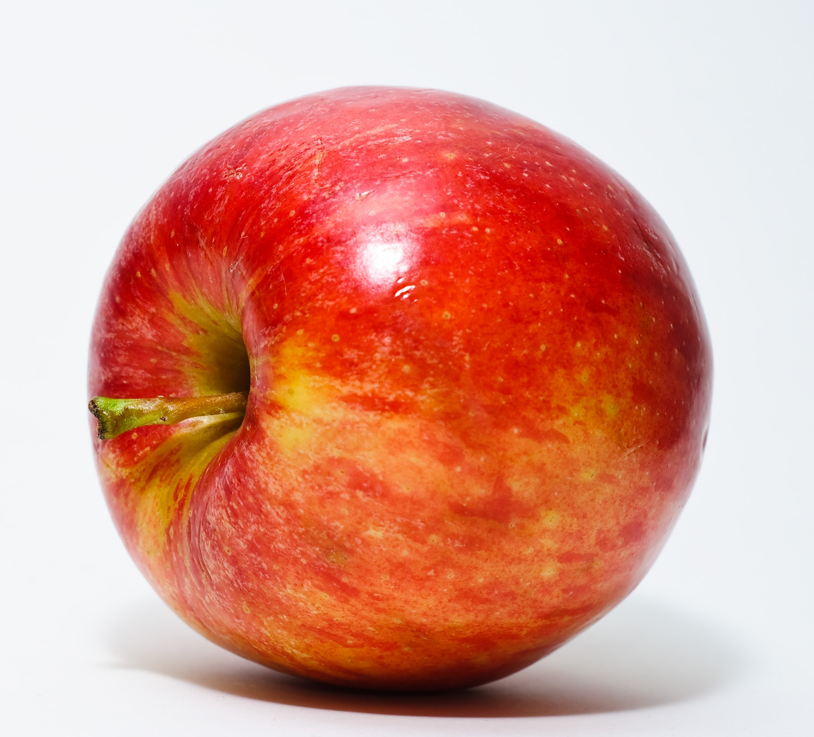
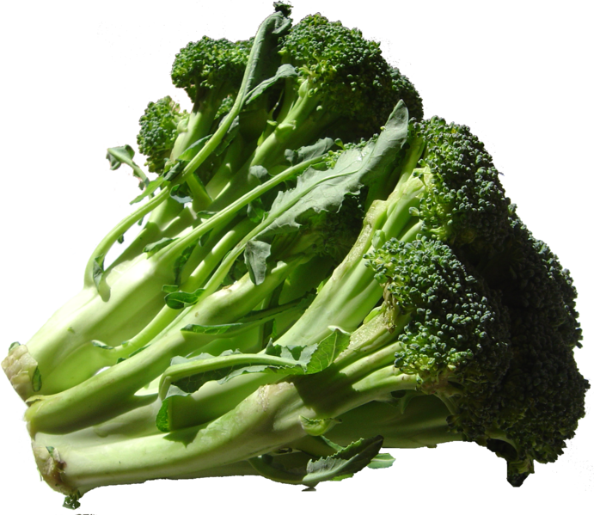
Yummy!
Notes:
Potential chemical energy in the chemical bonds in the apples and broccoli that the body will break to release the energy and convert into heat and muscle movement (kinetic) – the latter can perform work

Slide 12
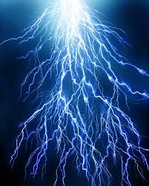
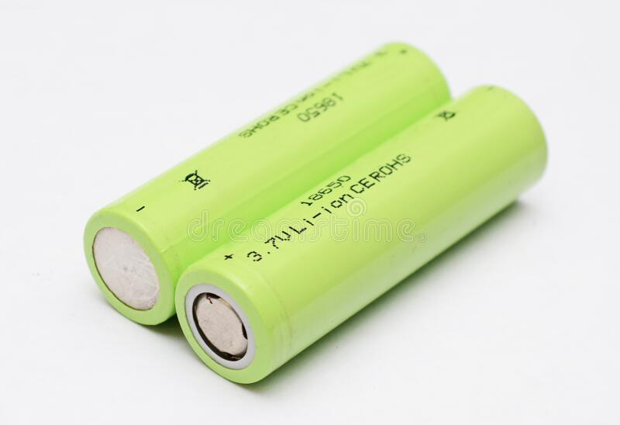

Heat, light, sound
Notes:
Students have to rearrange the top images into the right order for the energy chain. Student need to also include the type(s) of energy associated with each image and the energy transformation that occurs, for example potential chemical energy is transformed into electrical energy (kinetic)
Correct order: Potential chemical energy in battery – kinetic energy in electron through circuit to generate electrical energy – mobile phone - that converts electrical energy into heat, light and sound

Slide 13

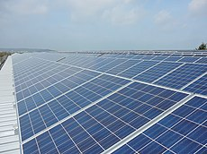

Notes:
Student have to rearrange the top images into the right order for the energy chain. Student need to also include the type(s) of energy associated with each image and the energy transformation that occurs, for example potential chemical energy is transformed into electrical energy (kinetic)
Correct order is
Sun (kinetic energy in form of photons and electromagnetic radiation) – Solar panel – Electrical energy – Computer/electric vehicle
Solar panel converts the kinetic energy in a photon to electrical energy. The electrical energy is transformed into light and heat and computations (in computer) and kinetic energy (and heat) in EV

Slide 14








Mass = 6 kilograms
Force = ?
3 metres
Work = ?
Notes:
Force = mass × distance
What Force is required to move the box the 3 metres?
Work = Force × distance/displacement
What was the work done in this instance?
(18 × 3 = 54 NM – or 54 Joules)

Slide 15
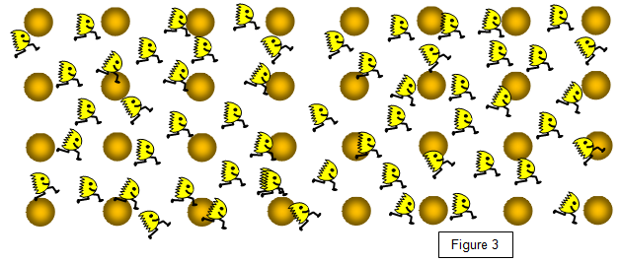
The electrons will interact with the atoms and lose energy – transfer of energy
Electrons
Atoms
Direction of electron flow
Adapted from © Keith Gibbs 2020
https://www.schoolphysics.co.uk
Notes:
What do you feel when you have a laptop on your lap or talking on a mobile phone on your ear?
Even best conductors have some resistance– energy in the electron is lost as heat
Insulators have really high resistance – it takes a lot of energy to get electrons to flow through that material.
The more interactions, the greater the resistance and the greater the energy loss. Materials with high resistance can make good insulators because of the difficulty to generate any current.
Materials with low resistance are good conductors because it requires only low voltages, or energy, to get the electrons moving. Imagine if we could develop a material that could conduct with no resistance – that is, no energy loss. There would be no wasted energy as heat and you would only need a tiny amount of energy to generate the required current. FLEET and other research groups around the world are working to develop these zero-resistance materials to build the next generation of low-energy electronics.

